Slide 1
Software Development methodologies
By Vivek Gohil

Slide 2
Contents
Basic Principles of developing software programs
Right approach to programming
Introduction to Development Methodologies

Slide 3
Basic Principles of developing software programs
Understanding problem statements.
Interpreting requirements.
Designing solutions to problems.
Techniques of problem solving.
Understanding the concept of algorithms

Slide 4
Understanding problem statements
Understanding problem statement is the most important and necessary stage in software development.
The senior members of the team perform it with inputs from all stakeholders and domain experts or SMEs in industry.
Planning for the quality assurance requirements and identification of the risks associated with the project.
Business analyst and project organizer set up a meeting with client to gather all the data.
what customer wants to build ?
Who will be the end user ?
What is the objective of the product ?

Slide 5
Understanding problem statements
Example : A client wants to have an application which concerns money transactions. In this method, the requirement has to be precise like what kind of operations will be done, how it will be done, in which currency it will be done, etc.

Slide 6
Interpreting requirements
Once the required function is done, an analysis is complete with auditing the feasibility of the growth of a product. In case of any ambiguity, a signal is set up for further discussion.
Once the requirement is understood, the SRS (Software Requirement Specification) document is created. The developers should thoroughly follow this document and also should be reviewed by the customer for future reference.

Slide 7
Interpreting requirements
Once the requirement analysis is done, the next stage is to certainly represent and document the software requirements and get them accepted from the project stakeholders.
This is accomplished through "SRS"- Software Requirement Specification document which contains all the product requirements to be constructed and developed during the project life cycle.

Slide 8
Designing solutions to problems
The next phase is about to bring down all the knowledge of requirements, analysis, and design of the software project.
This phase is the product of the last two, like inputs from the customer and requirement gathering.

Slide 9
Techniques of problem solving
To solve problem we have multiple approach like
Flowcharting
Data Flow Diagram
Pseudocode

Slide 10
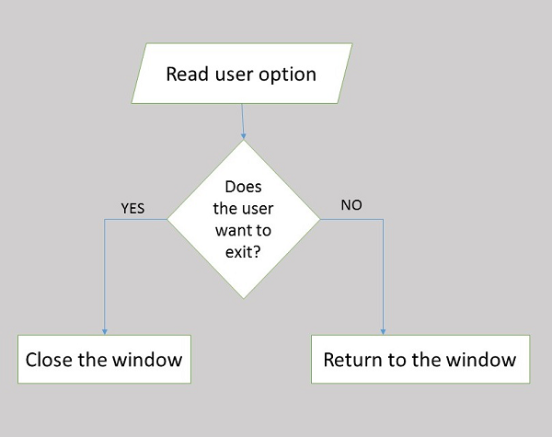
Techniques of problem solving : Flowcharting
Flowcharting is the process of illustrating workflows and data flows in a system through symbols and diagrams. It is an important tool to assist the system analyst in identifying a solution to the problem. It depicts the components of the system visually.

Slide 11
Techniques of problem solving : Flowcharting
These are the advantages of flowcharting
Visual representation helps in understanding program logic
They act as blueprints for actual program coding
Flowcharts are important for program documentation
Flowcharts are an important aid during program maintenance
These are the disadvantages of flowcharting
Complex logic cannot be depicted using flowcharts
In case of any change in logic or data/work flow, flowchart has to be redrawn completely

Slide 12
Techniques of problem solving : Data Flow Diagram
Data flow diagram or DFD is a graphical representation of data flow through a system or sub-system.
Each process has its own data flow and there are levels of data flow diagrams.
Then the system is broken down into modules and level 1 DFD shows data flow for each module separately.
Modules may further be broken down into sub-modules if required and level 2 DFD drawn.

Slide 13
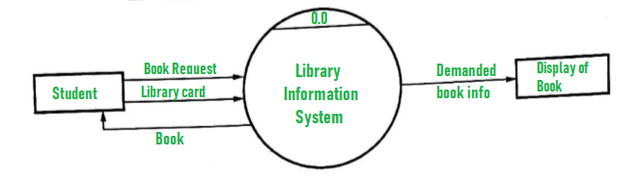
Techniques of problem solving : Data Flow Diagram
Level 0 DFD

Slide 14
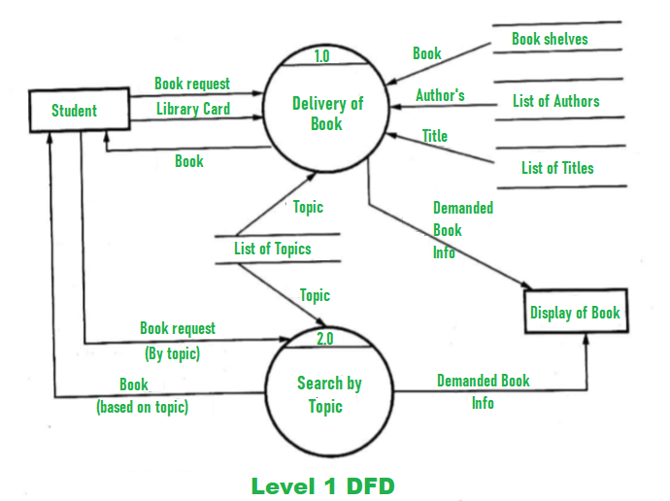
Techniques of problem solving : Data Flow Diagram
Level 1 DFD

Slide 15
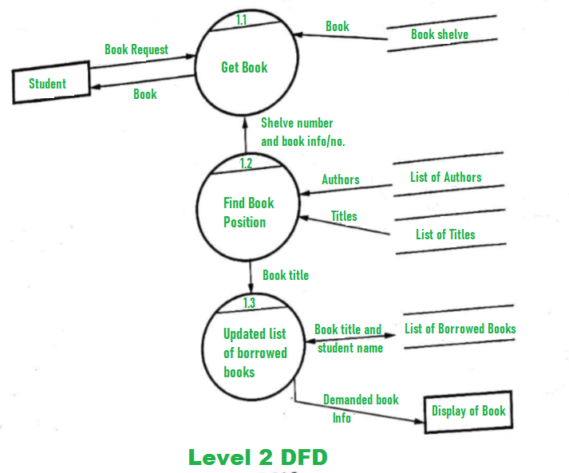
Techniques of problem solving : Data Flow Diagram
Level 2 DFD

Slide 16
Understanding the concept of algorithms
A finite set of steps that must be followed to solve any problem is called an algorithm.
Algorithm is generally developed before the actual coding is done.
It is written using English like language so that it is easily understandable even by non-programmers.
Sometimes algorithms are written using pseudocodes, i.e. a language similar to the programming language to be used.

Slide 17
Understanding the concept of algorithms
Writing algorithm for solving a problem offers these advantages
Promotes effective communication between team members
Enables analysis of problem at hand
Acts as blueprint for coding
Assists in debugging
Becomes part of software documentation for future reference during maintenance phase

Slide 18
Understanding the concept of algorithms
These are the characteristics of a good and correct algorithm
Has a set of inputs
Steps are uniquely defined
Has finite number of steps
Produces desired output

Slide 19
Understanding the concept of algorithms
Let us first take an example of a real-life situation for creating algorithm. Here is the algorithm for going to the market to purchase a pen.
Get dressed to go the market.
Check your wallet for money.
If there is no money in the wallet , replenish it.
Go to shop.
Ask for your favorite brand of pen.
If pen is not available , go to step 10 else go to step 7.
Give money to the shopkeeper.
Keep the purchased pen safely
Go back home.
Ask for any other brand of pen.
Go to step 7

Slide 20
Understanding the concept of algorithms
Step 4 in this algorithm is in itself a complete task and separate algorithm can be written for it.
Let us now create an algorithm to check whether a number is positive or negative.
Print “Give any number”
Read num
If(num==0) print “You entered 0”
If(num>0) print “You entered a positive number”
If(num<0) print “You entered a negative number”

Slide 21
Approach to Programming
Top-down approach.
Bottom up approach
Top-down VS Bottom-up

Slide 22
Top-down v/s bottom up approach
Here the problem is broken down into logical units rather than functional units.
Problem has to be broken down into smaller units. To do this, developers use any of the following two approaches
Top-down approach
Bottom-up approach

Slide 23
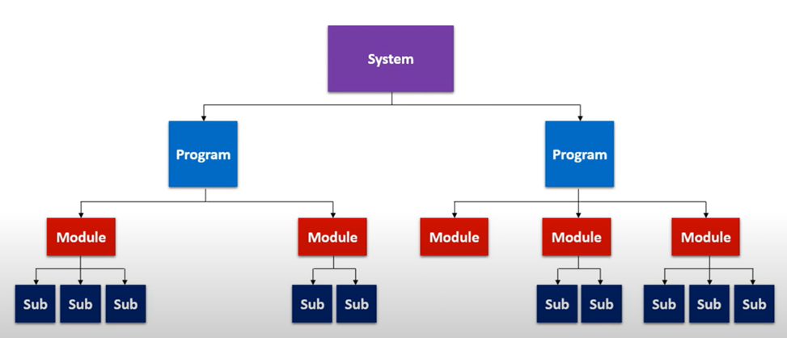
Top-down or Modular Approach
In the top-down model, an overview of the system is formulated without going into detail for any part of it.
Each part of it then refined into more details, defining it in yet more details until the entire specification is detailed enough to validate the model.

Slide 24
Top-down or Modular Approach
Advantages
Breaking problems into parts help us to identify what needs to be done.
At each step of refinement, new parts will become less complex and therefore easier to solve.
Parts of the solution may turn out to be reusable.
Breaking problems into parts allows more than one person to solve the problem.

Slide 25
Bottom-Up Design Model
In this design, individual parts of the system are specified in detail.
The parts are linked to form larger components, which are in turn linked until a complete system is formed.
Object-oriented language such as C++ or java or C# uses a bottom-up approach where each object is identified first.
Advantage
Make decisions about reusable low-level utilities then decide how there will be put together to create high-level construct.

Slide 26
Top-down v/s bottom up approach
Top-Down
Bottom Up
In this approach We focus on breaking up the problem into smaller parts.
Mainly used by structured programming language such as COBOL, Fortran, C, etc.
Each part is programmed separately therefore contain redundancy.
In this the communications is less among modules.
It is used in debugging, module documentation, etc.
In bottom up approach, we solve smaller problems and integrate it as whole and complete the solution.
Mainly used by object oriented programming language such as C++, C#, Python.
Redundancy is minimized by using data encapsulation and data hiding.
In this module must have communication.
It is basically used in testing.

Slide 27
Methodologies for software development
Waterfall development method.
Rapid development method.
Agile development methodology.
DevOps deployment methodology.

Slide 28
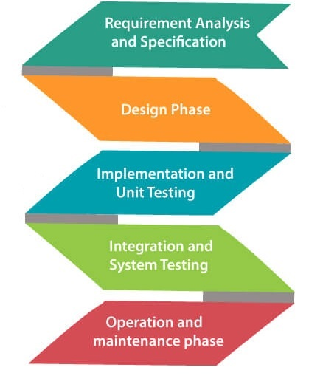
Waterfall development method
Winston Royce introduced the Waterfall Model in 1970.
This model has five phases:
Requirements analysis and specification
Design
Implementation,
Unit testing Integration and system testing,
operation and maintenance.

Slide 29
Waterfall development method : Requirements analysis and specification
The aim of this phase is to understand the exact requirements of the customer and to document them properly.
Both the customer and the software developer work together so as to document all the functions, performance, and interfacing requirement of the software.
It describes the “what” of the system to be produced and not “how”. In this phase, a large document called Software Requirement Specification (SRS) document is created which contained a detailed description of what the system will do in the common language.

Slide 30
Waterfall development method : Design Phase
This phase aims to transform the requirements gathered in the SRS into a suitable form which permits further coding in a programming language.
It defines the overall software architecture together with high level and detailed design.
All this work is documented as a Software Design Document (SDD).

Slide 31
Waterfall development method : Implementation and unit testing
During this phase, design is implemented.
If the SDD is complete, the implementation or coding phase proceeds smoothly, because all the information needed by software developers is contained in the SDD.
During testing, the code is thoroughly examined and modified if required.

Slide 32
Waterfall development method : Integration and System Testing
This phase is highly crucial as the quality of the end product is determined by the effectiveness of the testing carried out.
The better output will lead to satisfied customers, lower maintenance costs, and accurate results.
Unit testing determines the efficiency of individual modules.
However, in this phase, the modules are tested for their interactions with each other and with the system.

Slide 33
Waterfall development method : Operation and maintenance phase
Maintenance is the task performed by every user once the software has been delivered to the customer, installed, and operational.

Slide 34
Waterfall development method
When to use SDLC Waterfall Model?
When the requirements are constant and not changed regularly.
A project is short
The situation is calm
Where the tools and technology used is consistent and is not changing
When resources are well prepared and are available to use.

Slide 35
Waterfall development method
Advantages of Waterfall model
This model is simple to implement also the number of resources that are required for it is minimal.
The requirements are simple and explicitly declared; they remain unchanged during the entire project development.
The start and end points for each phase is fixed, which makes it easy to cover progress.
The release date for the complete product, as well as its final cost, can be determined before development.
It gives easy to control and clarity for the customer due to a strict reporting system.

Slide 36
Waterfall development method
Disadvantages of Waterfall model
In this model, the risk factor is higher, so this model is not suitable for more significant and complex projects.
This model cannot accept the changes in requirements during development.
It becomes tough to go back to the phase. For example, if the application has now shifted to the coding phase, and there is a change in requirement, It becomes tough to go back and change it.
Since the testing done at a later stage, it does not allow identifying the challenges and risks in the earlier phase, so the risk reduction strategy is difficult to prepare.

Slide 37
RAD (Rapid Application Development) Model
RAD is a linear sequential software development process model that emphasizes a concise development cycle using an element based construction approach.
If the requirements are well understood and described, and the project scope is a constraint, the RAD process enables a development team to create a fully functional system within a concise time period.

Slide 38
RAD (Rapid Application Development) Model
RAD (Rapid Application Development) is a concept that products can be developed faster and of higher quality through:
Gathering requirements using workshops or focus groups
Prototyping and early, reiterative user testing of designs
The re-use of software components
A rigidly paced schedule that refers design improvements to the next product version
Less formality in reviews and other team communication

Slide 39
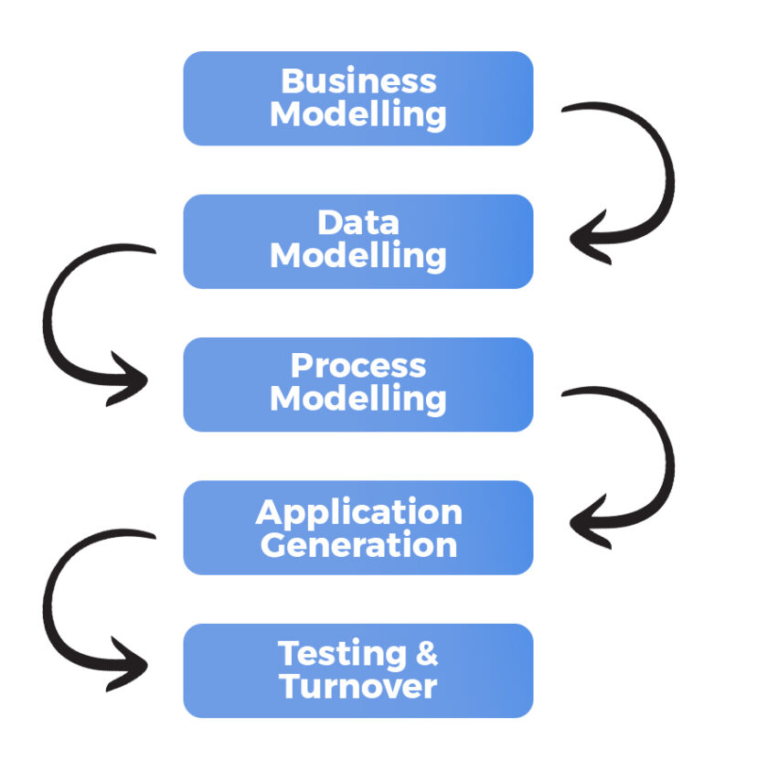
RAD (Rapid Application Development) Model
The various phases of RAD are as follows
Business Modelling
Data Modelling
Process Modelling
Application Generation
Testing and Turnover

Slide 40
RAD (Rapid Application Development) Model
The various phases of RAD are as follows
Business Modelling
The information flow among business functions is defined by answering questions like what data drives the business process, what data is generated, who generates it, where does the information go, who process it and so on.
Data Modelling
The data collected from business modeling is refined into a set of data objects (entities) that are needed to support the business. The attributes (character of each entity) are identified, and the relation between these data objects (entities) is defined.
Process Modelling
The information object defined in the data modeling phase are transformed to achieve the data flow necessary to implement a business function. Processing descriptions are created for adding, modifying, deleting, or retrieving a data object.

Slide 41
RAD (Rapid Application Development) Model
The various phases of RAD are as follows : Continue
Application Generation
Automated tools are used to facilitate construction of the software.
Testing and Turnover
Many of the programming components have already been tested since RAD emphasis reuse. This reduces the overall testing time. But the new part must be tested, and all interfaces must be fully exercised.

Slide 42
RAD (Rapid Application Development) Model
When to use RAD Model?
When the system should need to create the project that modularizes in a short span time (2-3 months).
When the requirements are well-known.
When the technical risk is limited.
When there's a necessity to make a system, which modularized in 2-3 months of period.
It should be used only if the budget allows the use of automatic code generating tools.

Slide 43
RAD (Rapid Application Development) Model
Advantage of RAD Model
This model is flexible for change.
In this model, changes are adoptable.
Each phase in RAD brings highest priority functionality to the customer.
It reduced development time.
It increases the reusability of features.

Slide 44
RAD (Rapid Application Development) Model
Disadvantage of RAD Model
It required highly skilled designers.
All application is not compatible with RAD.
For smaller projects, we cannot use the RAD model.
On the high technical risk, it's not suitable.
Required user involvement.

Slide 45

Agile Model
The meaning of Agile is swift or versatile.

Slide 46
Agile Model
"Agile process model" refers to a software development approach based on iterative development.
Agile methods break tasks into smaller iterations, or parts do not directly involve long term planning.
The project scope and requirements are laid down at the beginning of the development process.
Plans regarding the number of iterations, the duration and the scope of each iteration are clearly defined in advance.

Slide 47
Agile Model
Each iteration is considered as a short time "frame" in the Agile process model, which typically lasts from one to four weeks.
The division of the entire project into smaller parts helps to minimize the project risk and to reduce the overall project delivery time requirements.
Each iteration involves a team working through a full software development life cycle including planning, requirements analysis, design, coding, and testing before a working product is demonstrated to the client.

Slide 48
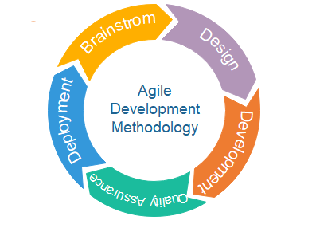
Agile Model : Phases
Requirements gathering
Design the requirements
Construction/ iteration
Testing/ Quality assurance
Deployment
Feedback

Slide 49
Agile Model : Phases
Requirements gathering
In this phase, you must define the requirements.
You should explain business opportunities and plan the time and effort needed to build the project.
Based on this information, you can evaluate technical and economic feasibility.
Design the requirements
When you have identified the project, work with stakeholders to define requirements.
You can use the user flow diagram or the high-level UML diagram to show the work of new features and show how it will apply to your existing system.

Slide 50
Agile Model : Phases
Construction/ iteration
When the team defines the requirements, the work begins. Designers and developers start working on their project, which aims to deploy a working product. The product will undergo various stages of improvement, so it includes simple, minimal functionality.
Testing/ Quality assurance
In this phase, the Quality Assurance team examines the product's performance and looks for the bug.
Deployment
In this phase, the team issues a product for the user's work environment.
Feedback
After releasing the product, the last step is feedback. In this, the team receives feedback about the product and works through the feedback.

Slide 51
Agile methodologies that support Agile Development
Scrum – Most Popular
Crystal
Lean Software Development
eXtreme Programming(XP)
Kanban

Slide 52
Agile Methodologies : Scrum
Scrum
Is a lightweight Agile Methodology.
In Scrum we break the large and complex project into smaller one and review and adopting along the way.
Reviewing and Adopting along the way means
With Scrum you write your plan and do more in short iteration or cycle that we call Sprints.
Instead of working on project deadline you constantly deliver functioning products throughout the cycle.
You don’t use the final evaluation , instead you receive the continues feedback from your customer and improvise your product.

Slide 53
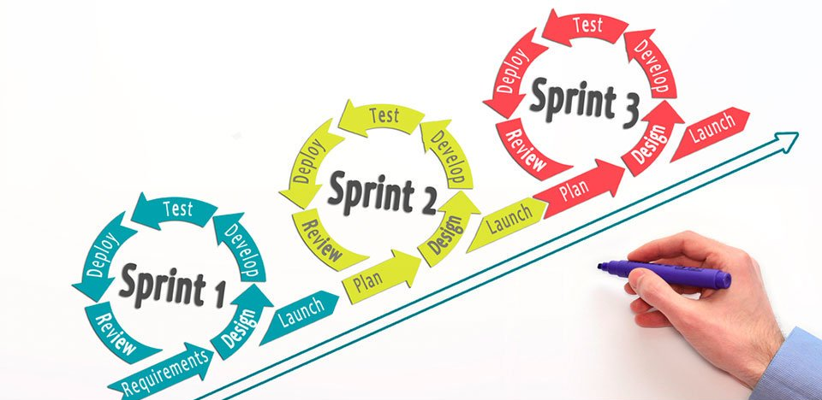
Agile Methodologies : Scrum

Slide 54
Agile Methodologies : Scrum
What are the Roles in Scrum?
Product Owner
Scrum Master
Team

Slide 55
Agile Methodologies : Scrum
Problem : Suppose there a number of people in a room and they have to queue up according to their respective height , taking minimum amount of time possible.

Slide 56
Agile Methodologies : Scrum
Solution 1: The Supervisor Approach
Disadvantages of Supervisor Approach
Will take lot of time
You will not learn anything / No new learning.

Slide 57

Agile Methodologies : Scrum
Solution 2 : Agile Approach – Using Scrum Master
Scrum master allows team to organize themself.
At the end he/she will do the changes if necessary
The Scrum Master is not a supervisor.
Also the self organization dose no mean absence of management.
Advantages of Agile Approach
People/Team is self organized and takes less time – Under the continues guidance of Scrum Master.

Slide 58
DevOps deployment methodology
DevOps combines development (Dev) and operations (Ops) to unite people, process, and technology in application planning, development, delivery, and operations.
DevOps enables coordination and collaboration between formerly siloed roles like development, IT operations, quality engineering, and security.

Slide 59
DevOps Architecture
Development and operations both play essential roles in order to deliver applications.
The deployment comprises analyzing the requirements, designing, developing, and testing of the software components or frameworks.
The operation consists of the administrative processes, services, and support for the software.
When both the development and operations are combined with collaborating, then the DevOps architecture is the solution to fix the gap between deployment and operation terms; therefore, delivery can be faster.

Slide 60
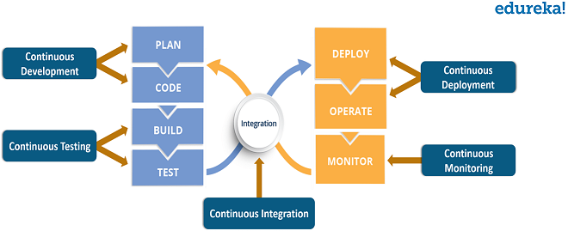
What is DevOps Life cycle?
The DevOps life cycle has various phases such as
Continuous development
Continuous integration
Continuous testing
Continuous deployment
Continuous monitoring.

Slide 61
Continuous development
This is the phase that involves ‘planning‘ and ‘coding‘ of the software.
The vision of the project is decided during the planning phase and the developers begin developing the code for the application.
There are no DevOps tools that are required for planning, but there are a number of tools for maintaining the code.
The code can be written in any language, but it is maintained by using Version Control tools.
Maintaining the code is referred to as Source Code Management.

Slide 62
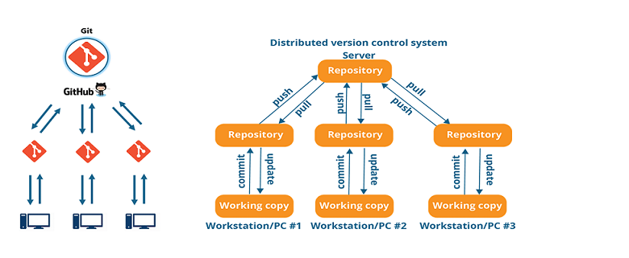
Continuous development
The most popular tools used are Git, SVN, Mercurial, CVS, and JIRA. Also tools like Ant, Maven, Gradle can be used in this phase for building/ packaging the code into an executable file that can be forwarded to any of the next phases.

Slide 63
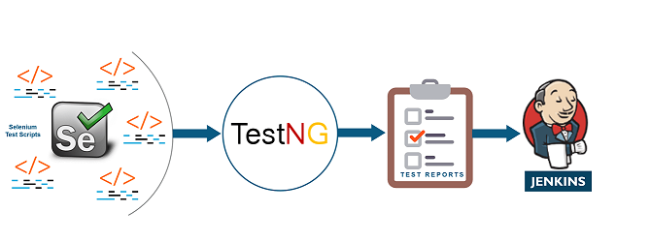
Continuous Testing
This is the stage where the developed software is continuously tested for bugs. For Continuous testing, automation testing tools like Selenium, TestNG, JUnit, etc are used.
These tools allow QAs to test multiple code bases thoroughly in parallel to ensure that there are no flaws in the functionality.
In this phase, Docker Containers can be used for simulating the test environment.

Slide 64
Continuous Integration - CI
This stage is the heart of the entire DevOps life cycle.
It is a software development practice in which the developers require to commit changes to the source code more frequently.
This may be on a daily or a weekly basis.
Every commit is then built and this allows early detection of problems if they are present.
Building code not only involves compilation but it also includes code review, unit testing, integration testing, and packaging.

Slide 65
Continuous Integration - CI
The code supporting new functionality is continuously integrated with the existing code.
Since there is continuous development of software, the updated code needs to be integrated continuously as well as smoothly with the systems to reflect changes to the end-users.

Slide 66
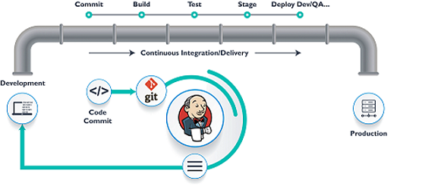
Continuous Integration - CI
Jenkins is a very popular tool used in this phase.
Whenever there is a change in the Git repository, Jenkins fetches the updated code and it prepares a build of that code which is an executable file in the form of a war or a jar.
This build is then forwarded to the test server or the production server.

Slide 67
Continuous Deployment - CD
This is the stage where the code is deployed to the production servers.
It is also important to ensure that the code is correctly deployed on all the servers.
Before moving on, let us try to understand a few things about Configuration management and Containerization tools. These set of tools here help in achieving Continuous Deployment (CD).

Slide 68
Continuous Deployment - CD
Since the new code is deployed on a continuous basis, configuration management tools play an important role in executing tasks quickly and frequently.
Some popular tools that are used here are Puppet, Chef, SaltStack, and Ansible.

Slide 69
Continuous Deployment - CD
Containerization tools also play an equally important role in the deployment stage.
Docker and Vagrant are the popular tools used for this purpose.
These tools help produce consistency across Development, Test, Staging and Production environments.
Besides this, they also help in scaling-up and scaling-down of instances swiftly.

Slide 70
Continuous Monitoring
This is a very crucial stage of the DevOps life cycle where you continuously monitor the performance of your application. Here vital information about the use of the software is recorded.
This information is processed to recognize the proper functionality of the application.
The system errors such as low memory, server not reachable, etc are resolved in this phase.

Slide 71
Software Development methodologies
Recap
Thank you!!

